Slide 1

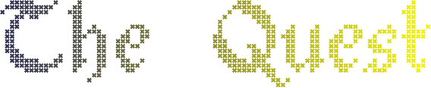

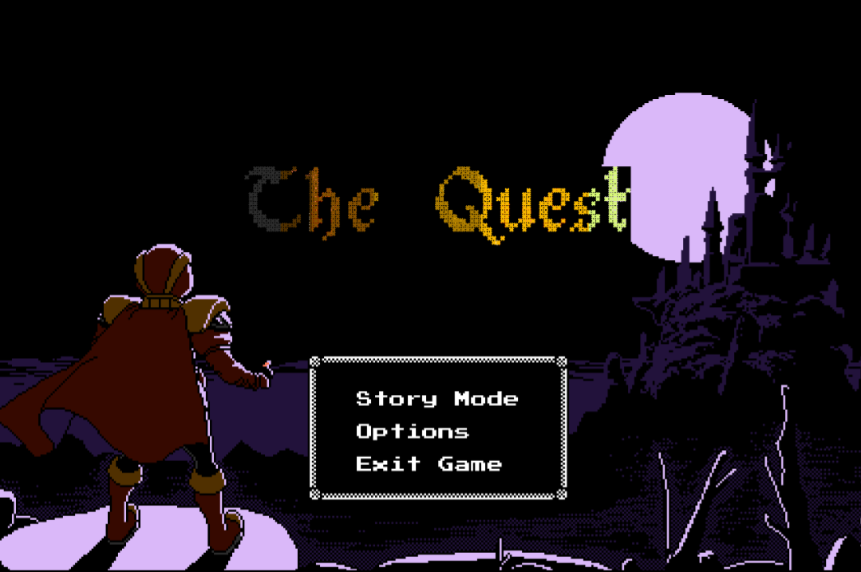
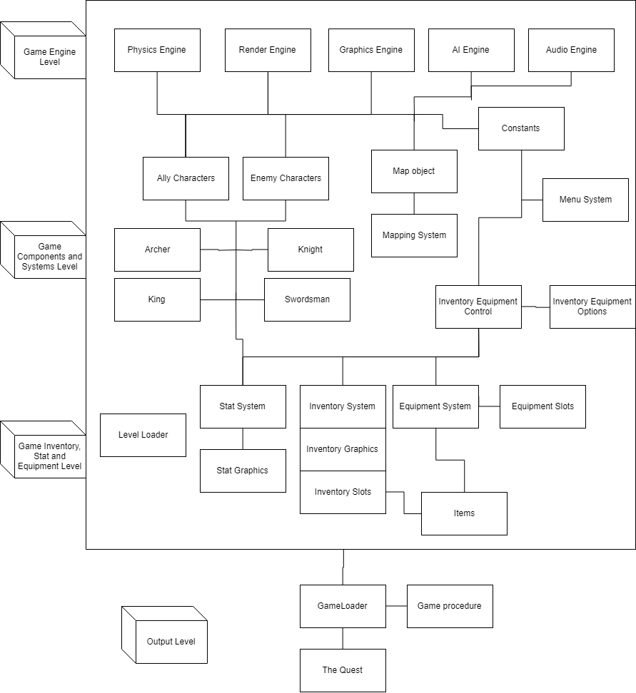
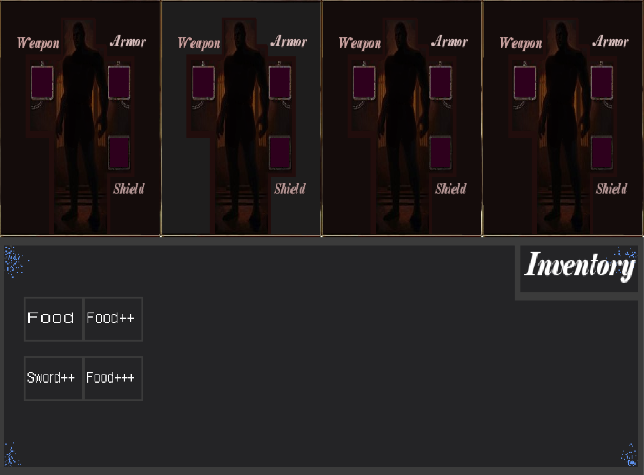
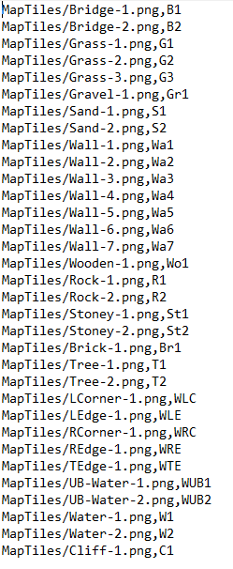
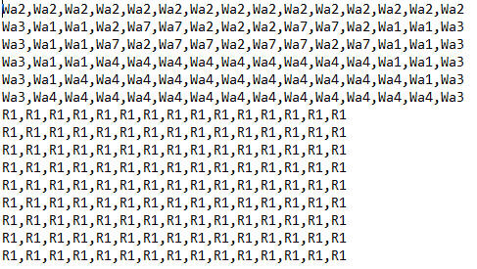
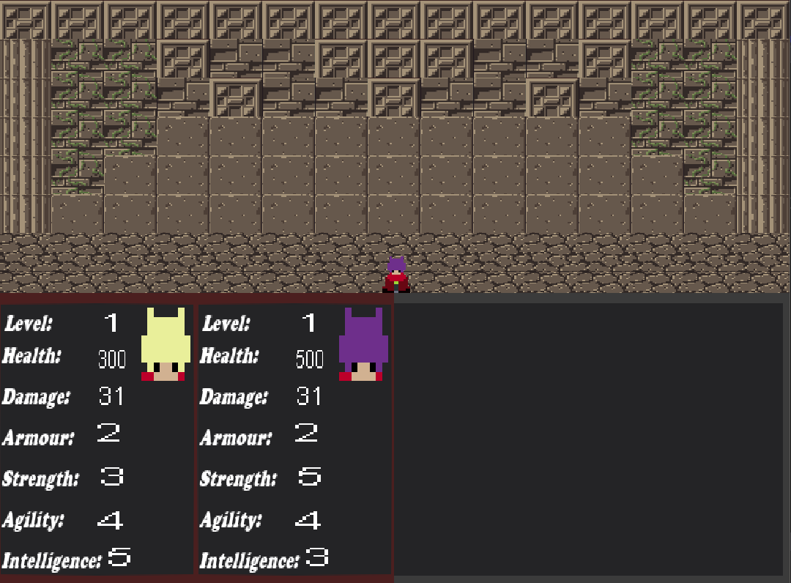
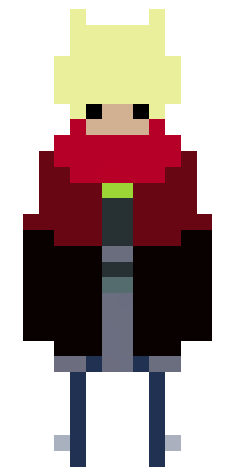
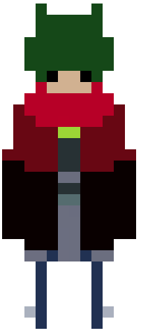
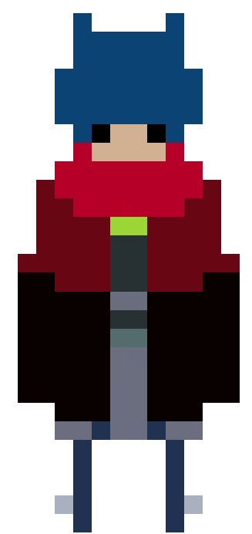
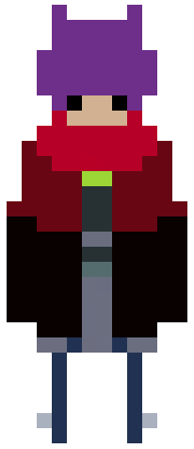
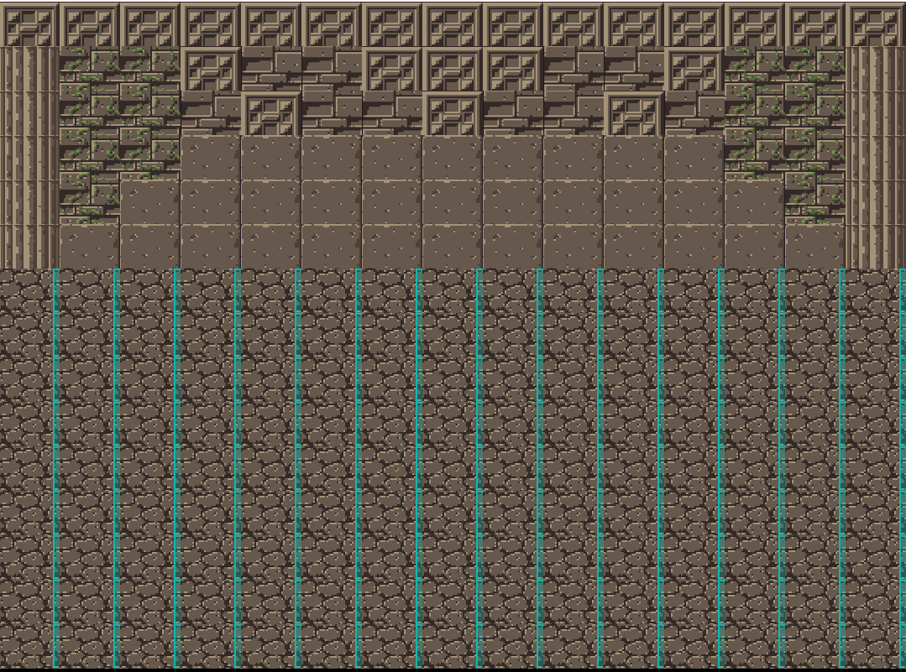
Tile-Based RPG
Name: Mahrad Pisheh Var Supervisor: Richard Bartle
What is this Game?
The Quest is a top-down designed role playing game that allows the player to play with one to four characters in the game and the goal is to kill all enemies without losing all the playable characters.
The Story:
The story is about a king who lost his land and his throne. The king decides to redeem his honor by taking back his land and sit on the throne once again with the help of his best soldiers.
Characters:
King, Archer, Swordsman and Knight.
How is the game made?
The Game is written in C++ with SDL libraries. I have created a game engine which I used to implement my game. The engine acts as a framework that the game is built on.
Features:
- Engines : Physics, graphics, audio animation, rendering and ‘AI’ Engine..
Inventory System:
A set of items that can be transferred between inventory and equipment and each item equipped effects the character’s stats and abilities.
Stat Attribute System:
Describes each character’s stats, these consist of agility, strength and intelligence.
Map and Texture Loading System
Texture + Map-Code Level’s Map
- GUI for inventory:
An inventory GUI for managing the inventory and equipment. Each item can be easily removed, equipped and unequipped.
Character Stat Showcase
A suitable presentation for showing a character’s stat in-game by showing each character’s face and their stat details.
System Design
Future work:
My project consists of two important components, the game engine and the logic, The Quest is a way to represent my engine’s capabilities and with this engine I am able to create many different game genres.
Therefore, I will be working on enhancing my game engine by adding new features to increase it’s usability in the future.
King
Archer
Swordsman
Knight

